Slide 1




COMPANY PROFILE
RMC2
CONSULTANCY CORP
Your trusted partner in Health, Life and Non-Life Coverage
www.rmc2consultancycorp.com

Slide 2


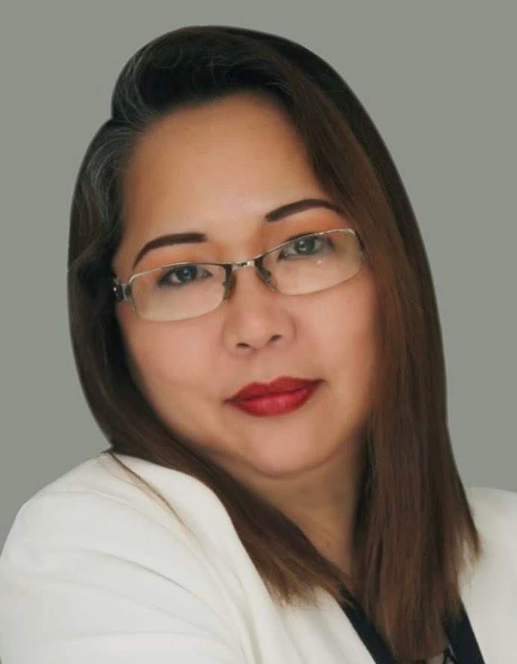
WHO WE ARE
At RMC2 Consultancy Corp, we believe that health and financial security should be accessible to everyone. Founded by Rosemarie Fernandez, who has been in the insurance industry for over 23 years, RMC2 was established with a passion for making a difference. Rosemarie has been exposed to the various needs of the market and decided to create a bridge for Filipinos who are overwhelmed by the process of insurance, making it more accessible and understandable.
We specialize in providing affordable, convenient, and reliable HMO, Life, and Non-Life Insurance solutions tailored to meet diverse needs.
Our mission is simple: to bridge the gap between people and quality healthcare by offering plans that prioritize accessibility and peace of mind. We understand that navigating insurance options can be overwhelming — that's why we take pride in guiding our clients every step of the way, ensuring clarity, compassion, and personalized service.
With a commitment to building lasting relationships, RMC2 Consultancy Corp stands as a trusted partner in safeguarding the well-being and future of individuals, families, and businesses alike.
Let us help you protect what matters most.

Slide 3

ABOUT US
At RMC2, we are dedicated to redefining the insurance experience. We specialize in providing HMO, Life, and Non-Life Insurance solutions that put people first, ensuring that protection isn’t just a privilege but a right for all. Our approach is built on three core principles: Affordability, Accessibility, and Convenience.
We understand that navigating insurance can feel overwhelming, so we’ve made it our mission to simplify the process. From personalized plans to hassle-free assistance, we’re here every step of the way, helping individuals, families, and businesses secure their future with peace of mind.
At the heart of RMC2 is a commitment to building lasting relationships. Whether it’s ensuring quick access to healthcare or offering life protection tailored to your needs, we’re more than just an insurance provider.
We are your trusted partner in safeguarding what matters most which is protecting lives and empowering futures.

Slide 4

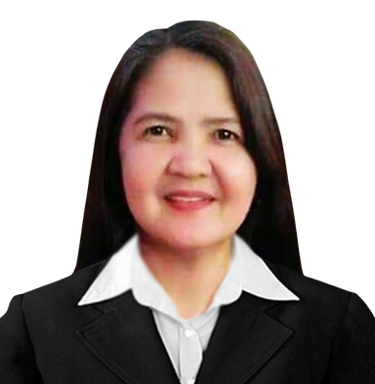


THE MANAGEMENT
ROSEMARIE FERNANDEZ
PRESIDENT & CEO
MICHELLE GUINTO
CHERRY CORTEZ
CLEMENT DOLF FERNANDEZ
CHARLES MARK UYBENGKEE
BOARD OF DIRECTOR
BOARD OF DIRECTOR
BOARD OF DIRECTOR
BOARD OF DIRECTOR

Slide 5

VISION
& MISSION
V > To break barriers where quality health and life protection is within everyone’s reach, ensuring affordability and accessibility for all.
M > To safeguard lives by delivering affordable and accessible HMO, Life, Non-Life Insurance solutions, ensuring everyone has the security and care they deserve.

Slide 6













OUR
PARTNERS
IN HEALTH

Slide 7





OUR
PARTNERS
IN LIFE

Slide 8







OUR
PARTNERS
IN NON-LIFE

Slide 9
















CLIENTS
WE SERVED
AND MORE

Slide 10


OUR GROWING NETWORK
RMC2 CONSULTANCY CORP
A growing consultancy firm for insurance solution with a strong client network, committed to promoting wellness, preventive health, and lifestyle benefits for its members.
1,200
15,300
900
SALES ADVISORS
GROUP ENROLLEES
INDIVIDUAL ACCOUNT
*DATA FROM
SEPTEMBER 2024 - NOVEMBER 2025

Slide 11

OUR
OFFICES
LUZON:
Cainta - HEAD OFFICE
Antipolo
Taytay
Bulacan
Valenzuela
Lipa
Pampanga - OPENING SOON
La Union
Baguio
Isabela
Bicol - OPENING SOON
Quezon City 1 & 2
Ilagan - OPENING SOON
VISAYAS:
Mandaue City - REGIONAL HEAD OFFICE
Cebu City - OPENING SOON
MINDANAO:
General Santos City

Slide 12








RMC2 PRODUCTS
IN PARTNERSHIP WITH AMAPHIL

Slide 13

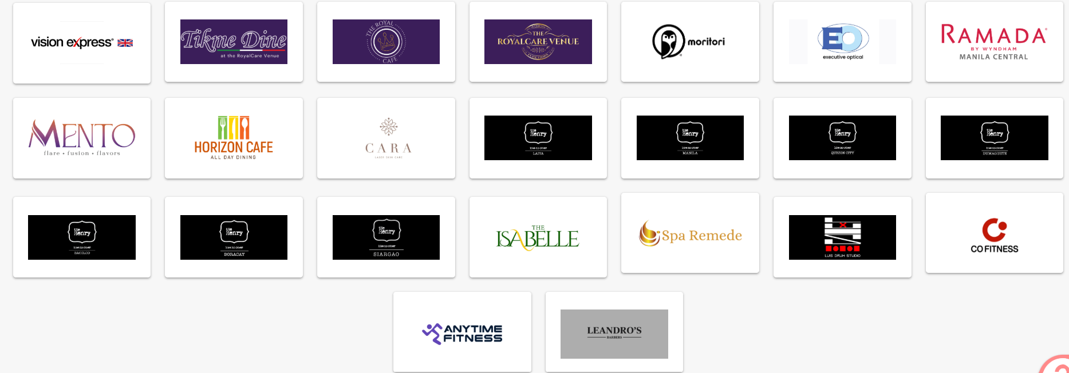
PARTNERSHIP PERKS

Slide 14



OUR NETWORK PROVIDER
Nationwide hospital and clinic accreditation thru our network provider AMAPHIL
AMAPHIL, or Advanced Medical Access Philippines, Inc., is a technology-powered Third Party Administrator (TPA) that was founded in 2016 to manage self-funded corporate health plans. It connects members to a large network of accredited hospitals, clinics, and physicians, and provides technology-driven services like online consultations via the Doctor Anywhere app. AMAPHIL's goal is to provide cost-effective, high-quality healthcare solutions for companies and their employees
www. amaphil.com.ph

Slide 15
OUR NETWORK PROVIDER
Corporate Officers
Ms. Irene Cara Gatus
Chairman
Ms. Mylene Benitez
Treasurer
Ms. Angeles Ongchangco
Corp Secretary
Ms. Mariane Odi
Board of Director
Atty. Ensign Icamen
Board of Director
www. amaphil.com.ph

Slide 16

Introducing:
Total CorpoShield
This plan is a comprehensive corporate health program designed to protect companies and their employees through total medical coverage, financial security, and wellness support. It combines the advantages of a managed healthcare system with flexible benefits that meet the diverse needs of the modern workforce.

Slide 17
Total CorpoShield
Variants
CorpoServe
CorpoAide
CorpoPlus
CorpoMax

Slide 18

ELEGIBILITY
PRINCIPAL
EMPLOYEES | ENTRY AGE | LAST AGE ACCEPTANCE | EXIT AGE
 | 18 | 65 | 66
Dependents
 | ENTRY AGE | LAST AGE ACCEPTANCE | EXIT AGE
Children | 5 | 23 | 24
Spouse/Parents | 18 | 60 | 61

Slide 19
HEALTHCARE BENEFITS
In Patient
Out Patient
Emergency Care
APE (Annual Physical Exam)
Dental Care
Financial Assistance

Slide 20
INPATIENT BENEFITS
Coverage | CorpoServe | CorpoAide | CorpoPlus | CorpoMax
Annual Benefit Limit (ABL) | ₱40,000.00 | ₱300,000.00 | ₱400,000.00 | ₱600,000.00
Maximum Benefit Limit (MBL) | ₱10,000.00 per illness per confinement per year | ₱70,000.00 per illness per confinement per year | ₱100,000.00 per illness per confinement per year | ₱150,000.00 per illness per confinement per year
Room Type | Open Ward | Open Semi-Private | Regular Private | Regular Private
Prescribed Medicine Reimbursement | PHP500 per confinement | PHP1,000 per confinement | PHP1,500 per confinement | PHP1,500 per confinement
Hospital Income Benefit (HIB) | PHP250 per day max. of 12 days per year | PHP350 per day max. of 12 days per year | PHP350 per day max. of 12 days per year | PHP350 per day max. of 12 days per year

Slide 21
INPATIENT BENEFITS
Room & board accommodation
Use of operating, ICU, isolation, or recovery room
Professional fees (physician, surgeon, anesthesiologist)
Nursing services, medicines, diagnostics, and supplies
Blood transfusions and fluids (recipient only)
Room upgrade (if room unavailable) – Up to 24 hours

Slide 22
OUT-PATIENT BENEFITS
QUARTERLY LIMIT
CorpoServe | CorpoAide | CorpoPlus | CorpoMax
1,500 | 6,000 | 15,000 | 18,000
Notes:
Corpoaide- 24k per year
CorpoPlus – 60k per year
CorpoMax – 72k per year

Slide 23
OUT-PATIENT BENEFITS
Comprehensive Consultations
Coverage | CorpoServe | CorpoAide | CorpoPlus | CorpoMax
Comprehensive Check Ups | Up to Quarterly Limit | Up to Quarterly Limit | Up to Quarterly Limit | Up to Quarterly Limit

Slide 24
OUT-PATIENT BENEFITS
Laboratory Tests and Procedures for Members (upon order of the Accredited Physician) up to the quarterly limit.
Includes:
• CBC, Creatinine, Urinalysis, Fecalysis
• Blood Uric Acid (BUA), Cholesterol, Triglycerides
• Blood Typing, Platelet Count
• Fasting Blood Sugar (FBS), HDL, LDL, BUN

Slide 25
OUT-PATIENT BENEFITS
Diagnostic Procedures (upon order of the Accredited Physician) up to the quarterly limit.
Includes:
• Chest X-ray
• Electrocardiogram (ECG)

Slide 26
OUT-PATIENT BENEFITS
Other diagnostic procedures not mentioned above have a maximum limit per year:
CorpoServe | CorpoAide | CorpoPlus | CorpoMax
2,000 | 5,000 | 5,000 | 5,000

Slide 27
OUT-PATIENT BENEFITS
COVERED for all Variants
MENTAL HEALTH CONSULTATION
1,500 consultation assistance per year to AMAPHIL-accredited psychiatrist.
PHYSICAL THERAPY
1,500 assistance per year to AMAPHIL-accredited PT centers or rehab doctors.

Slide 28

EMERGENCY CARE
In Affiliated Hospitals:
Physician's services
Emergency Room Fees
Medicines used for immediate relief during treatment
Oxygen, intravenous fluids and blood products
Dressings, conventional casts (plaster of Paris) and sutures
X-ray, laboratory , and diagnostic examinations, and other medical services related to the emergency treatment of the patient.

Slide 29
EMERGENCY CARE
Emergency treatment in non-affiliated
hospitals/clinics- 80% reimbursement based
on AMAPHIL RUV
Emergency treatment in affiliated
hospitals/clinics- 100% reimbursement based
on AMAPHIL RUV
Emergency treatment in areas without affiliated
hospitals/clinics (within a 15 km radius)
100% reimbursement based on AMAPHIL RUV
NOTE: Subject to plan limits

Slide 30

ANNUAL PHYSICAL EXAM
COVERED for all Variants
Physical Examination
Complete Blood Count
Urinalysis
Fecalysis
Chest X-ray
Can be availed at AMAPHIL accredited clinics with APE arrangements, or APE assistance of up to ₱350.

Slide 31

DENTAL CARE BENEFITS
a. Free & unlimited consultation & dental examinations
Simple tooth extraction, except surgery for impaction
(unlimited/maximum of 3 teeth per day)
c. Temporary fillings (up to 3 times a year)
Twice a year oral prophylaxis (mild to moderate) which can be availed of
after active membership (premium paid)/ succeeding may be availed of
six (6) months thereafter
e. Adjustment of dentures
f. Recementation of jacket crown inlays and onlays
g. Treatment of dental related pain excluding cost of prescribed medicines
h. Emergency desensitization of hypersensitive teeth
i. Annual dental examination (within the dentist’s dental clinic only)
j. Orthodontic and aesthetic dental consultation
COVERED for CorpoAide, CorpoPlus and CorpoMax only

Slide 32
FINANCIAL ASSISTANCE
Benefit Type | CorpoAide | CorpoPlus | CorpoMax
Accidental Death & Disablement | ₱100,000.00 | ₱100,000.00 | ₱100,000.00
Burial Expense | ₱5,000.00 | ₱5,000.00 | ₱5,000.00
Unprovoked murder and assault | ₱50,000.00 | ₱50,000.00 | ₱50,000.00
Note: No Financial Assistance for CorpoServe

Slide 33
PREMIUM-Principals
Number of Members | Mode of Payment | CorpoServe | CorpoAide | CorpoPlus | CorpoMax
For 5-49 Members | Annual | 4,740 | 6,048 | 10,584 | 15,876
 | Semi-Annual | 2,559 | 3,266 | 5,716 | 8,574
For 50 Members Above | Annual | 4,514 | 5,746 | 10,055 | 15,083
 | Semi-Annual | 2,438 | 3,103 | 5,431 | 8,146
**Add 50 for membership fee
Notes:
Annual Benefit Limit (ABL)
₱300,000.00
₱400,000.00
₱600,000.00
Maximum Benefit Limit (MBL)
₱70,000.00 per illness per confinement per year
₱100,000.00 per illness per confinement per year
₱150,000.00 per illness per confinement per year
You will also have the option to pay semi-annual mode.

Slide 34
PREMIUM - Dependents
Number of Members | Mode of Payment | CorpoServe | CorpoAide | CorpoPlus | CorpoMax
For 5-49 Members | Annual | 5,688 | 7,258 | 12,701 | 19,052
 | Semi-Annual | 3,041 | 3,920 | 6,860 | 10,289
For 50 Members Above | Annual | 5,417 | 6,896 | 12,066 | 18,100
 | Semi-Annual | 2,925 | 3,274 | 6,518 | 9,776
**Add 50 for membership fee

Slide 35
PRE EXISTING CONDITION
Illnesses, injuries, or medical conditions that existed prior to enrollment—such as hypertension, diabetes, asthma, tumors, or arthritis—are not covered unless specified under the plan after a designated waiting period, typically six (6) to twelve (12) months. Related complications or recurrences within the waiting period are likewise excluded.
However, the PEC exclusion is waived if at least 70% of eligible employees, with a minimum group size of 50 members, are enrolled under the plan. If this threshold is not met, pre-existing conditions will be covered after six (6) months of continuous membership.

Slide 36
PRE EXISTING CONDITION
Illnesses, injuries, or medical conditions that existed prior to enrollment—such as hypertension, diabetes, asthma, tumors, or arthritis—are not covered unless specified under the plan after a designated waiting period, typically six (6) to twelve (12) months. Related complications or recurrences within the waiting period are likewise excluded.
However, the PEC exclusion is waived if at least 70% of eligible employees, with a minimum group size of 50 members, are enrolled under the plan. If this threshold is not met, pre-existing conditions will be covered after six (6) months of continuous membership.

Slide 37

GENERAL EXCLUSIONS
1. Non-Medically Necessary or Cosmetic Procedures
Plastic or reconstructive surgery for cosmetic purposes (e.g., nose lift, liposuction, facelift). Treatment for obesity, weight reduction, or body contouring. Hair loss treatments, skin whitening, or tattoo removal. Corrective eye surgery for refractive errors (LASIK, etc.).
2. Dental Services Beyond Coverage
Orthodontic braces and retainers. Cosmetic dental procedures (veneers, bleaching). Dentures and prosthetics unless specifically included in the plan.
3. Congenital, Genetic, or Developmental Conditions
Congenital or hereditary diseases (unless included in special plans). Learning disabilities, speech therapy, or developmental therapy. Genetic testing and counseling.
4. Maternity and Reproductive Services
Normal pregnancy, childbirth, and postpartum care (unless maternity coverage is explicitly added). Fertility treatment, artificial insemination, in-vitro fertilization (IVF). Contraceptives, family planning procedures, or voluntary sterilization. Circumcision, except if medically necessary (e.g., infection).

Slide 38
GENERAL EXCLUSIONS
5. Mental Health, Psychiatric, and Psychological Disorders
Psychiatric evaluation, psychotherapy, counseling, and mental health admissions (except if explicitly covered).
Drug or alcohol rehabilitation, detoxification programs.
7. Occupational or Work-Related Injuries
Work-related accidents covered by the Employees Compensation Commission (ECC) or PhilHealth. Injuries from employment hazards or while performing job duties.
8. Self-Inflicted Injuries or Illegal Acts
Suicide or attempted suicide. Self-inflicted harm. Injuries due to participation in criminal acts or resistance to lawful arrest.
9. High-Risk or Hazardous Activities
Injuries from extreme sports or activities (e.g., scuba diving, skydiving, racing, mountaineering, martial arts competitions). Accidents while under the influence of drugs or alcohol.
10. Non-Prescription or Alternative Treatments
Vitamins, supplements, herbal or alternative medicines (e.g., acupuncture, chiropractic care, traditional healers).
Experimental or investigational treatments not approved by DOH or FDA.

Slide 39
GENERAL EXCLUSIONS
11. Non-Covered Diagnostic and Administrative Costs
Executive check-ups are not listed in the APE coverage. Medical certificates, fit-to-work, travel clearance, or police report requirements. Medical supplies not medically necessary (e.g., personal comfort items, toiletries).
12. Organ Transplants and Special Treatments
Organ donor expenses. Dialysis, chemotherapy, radiation, or immunotherapy unless specifically included.
Experimental surgical or medical procedures.
13. Conditions Covered by Government or Other Insurance
Treatments or conditions already covered by PhilHealth, SSS, or ECC benefits.
14. Out-of-Network Services
Consultations or treatments done outside affiliated hospitals/clinics (except for reimbursable emergencies). Overseas medical expenses (unless global coverage is stated).
Notes:
If we are going to decide which card to choose. We have to consider 2 major factors:
Benefits (inpatient,outpatient,emergency,financial assistance)
How convenient to use

Slide 40
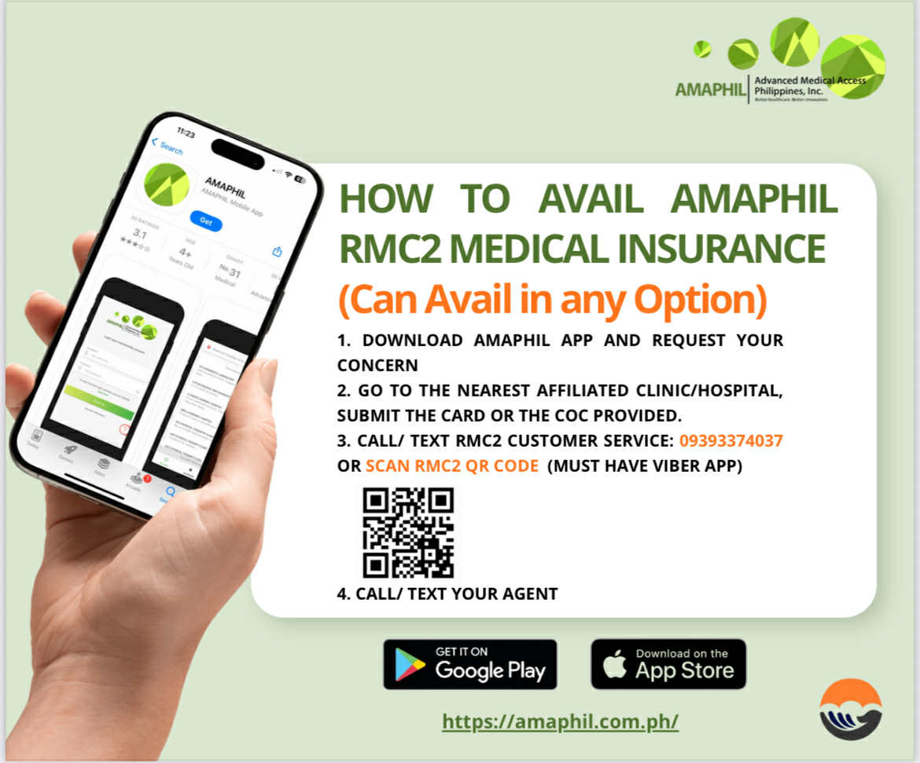

Slide 41
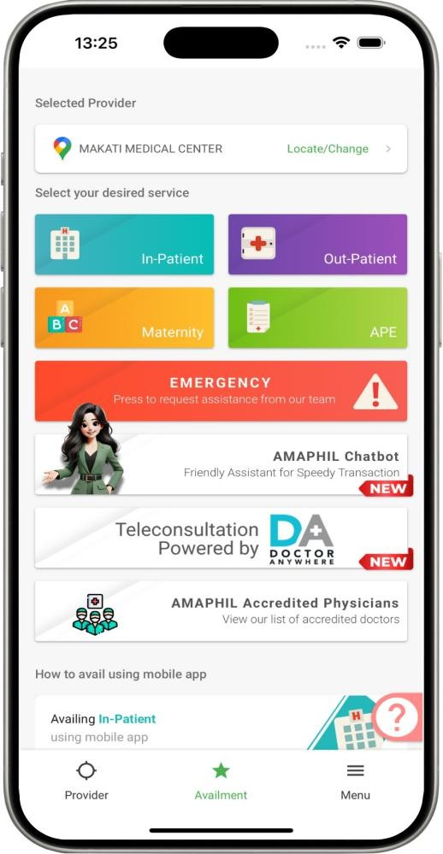
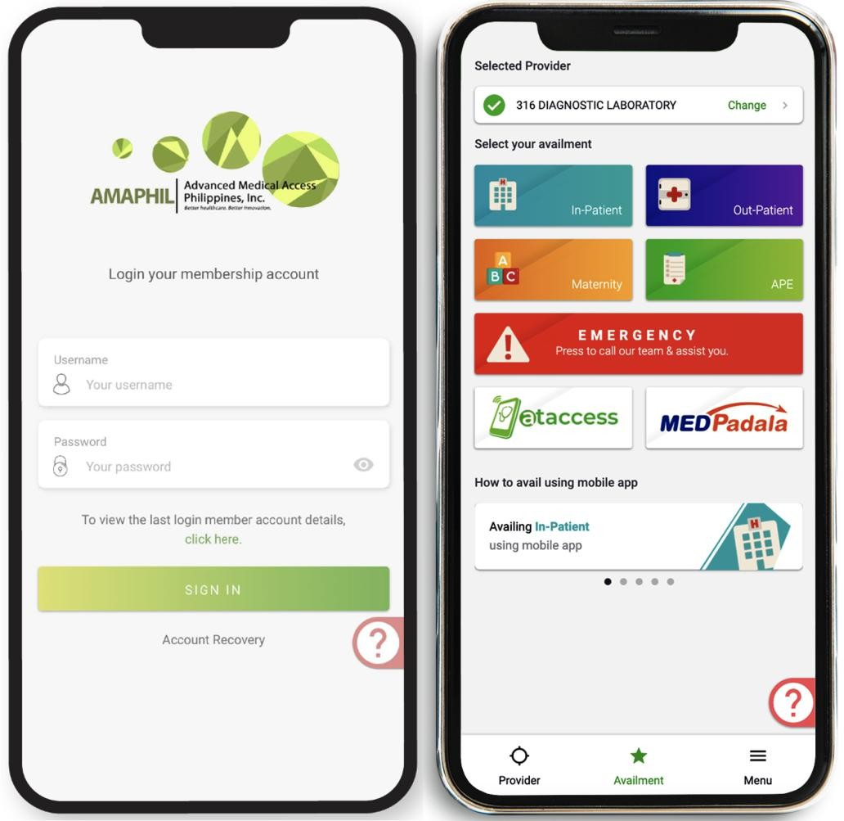
Member’s Mobile Application:
Through AMAPHIL’s mobile application, your employees may access
the following at their fingertips:
Request for LOA prior to availment;
File for reimbursement;
Review the list of benefits, exclusions and availment history;
View the latest list of providers;
See the reason for declined services;
Members can easily press Customer Service button in the Mobile
App and just wait for the AMAPHIL call.

Slide 42
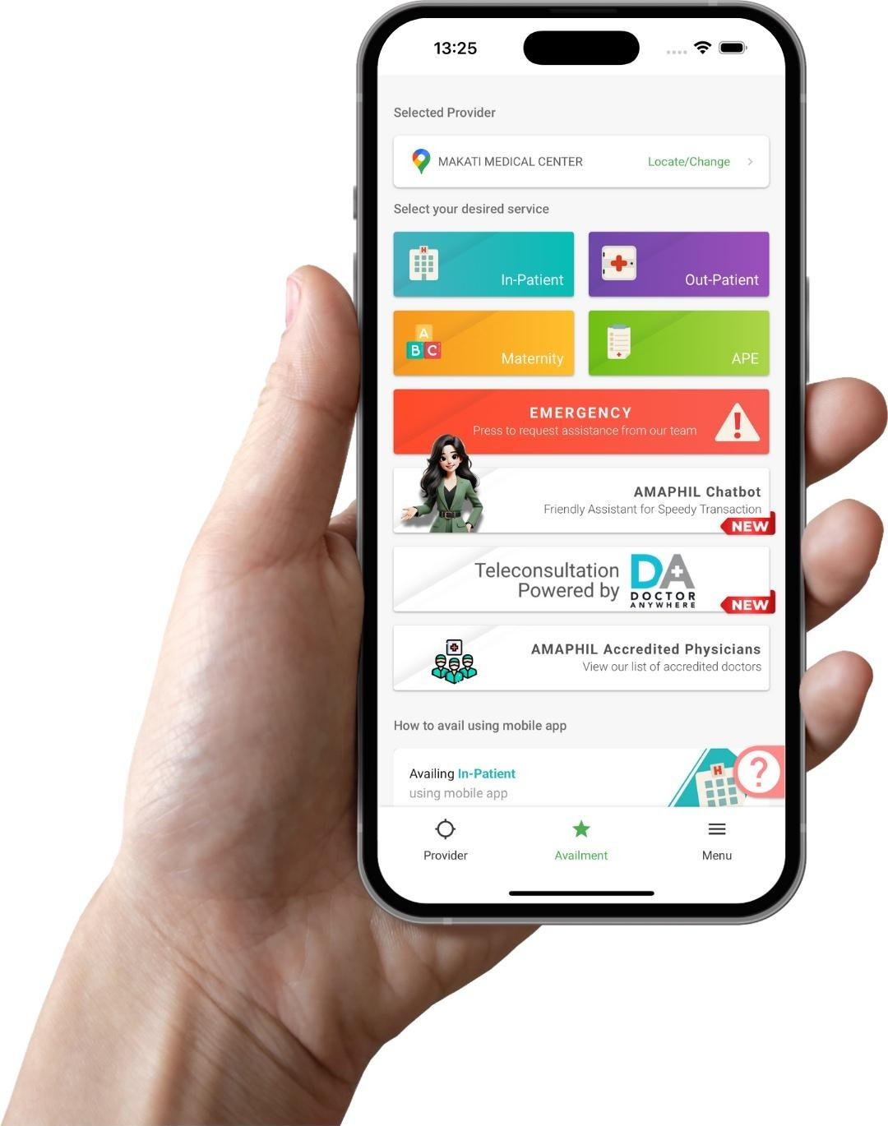
Members have immediate access to over 1,800 hospitals and clinics, and more than 51,000 doctors nationwide. Hence, there is no need to go through a tedious and expensive process of hospital and clinic affiliation.
Reduced patient wait times by using the AMAPHIL Mobile Application.
Notes:
If we are going to decide which card to choose. We have to consider 3 major factors:
Affordability. We offer the lowest in the market ( 6k per year or 5.7k for 50 above members. 300k ABL )
Benefits (inpatient,outpatient,emergency,financial assistance)
How convenient to use ( sobrang convenient ang approval using the amaphil mobile app)

Slide 43


THANK YOU!

